Slide 1


Purchase Order / Purchase Requisition Approval- Odoo ERP

Slide 2
Purchase Requisition General Overview
Whenever need for an item arises, the user will request items from the store through the use of planned transfer. If the item is available the stores personnel will validate the request and issue the item (s), if not a purchase request will be raised in odoo ERP to procure the item (s).
The purchase request will be sent to departmental manager for approval then forwarded to purchasing department to source from the suppliers and procure the item (s)

Slide 3
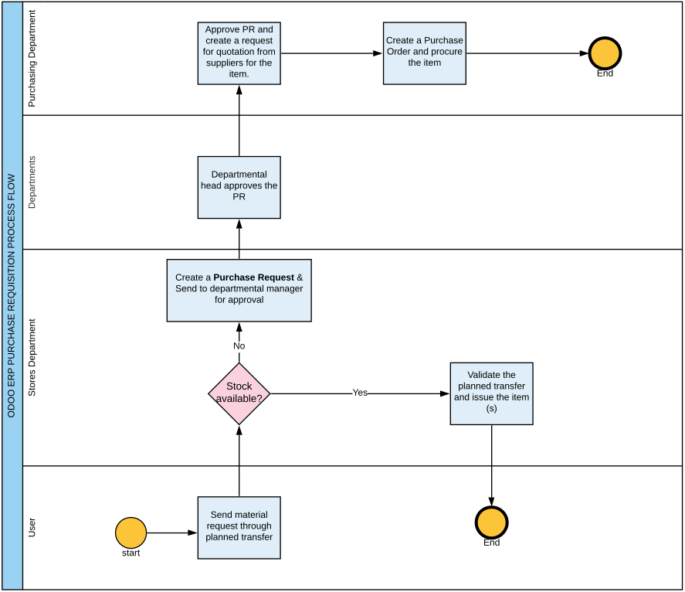

Slide 4
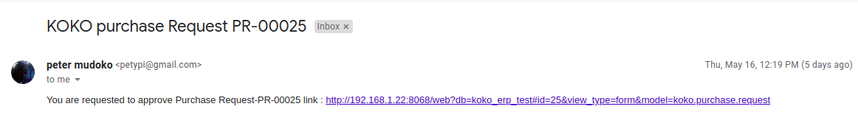
Approval Email to HOD
Once a purchase request is done in Odoo ERP, a notification mail will be sent to the HOD requesting him/her to approve. Click the link to proceed to the approval page.

Slide 5
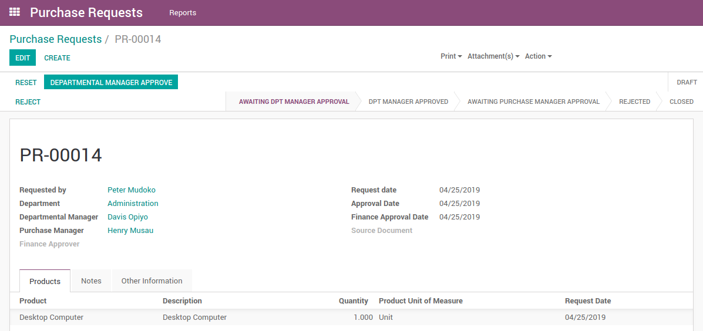
Departmental Manager Approval
Manager will login to Odoo and click on ‘Departmental Manager Approval’.

Slide 6
Purchase Manager Approval
Once the HOD approves, the Purchase Manager will receive a notification email to approve the PR and create the PO for the item. Click on the link

Slide 7
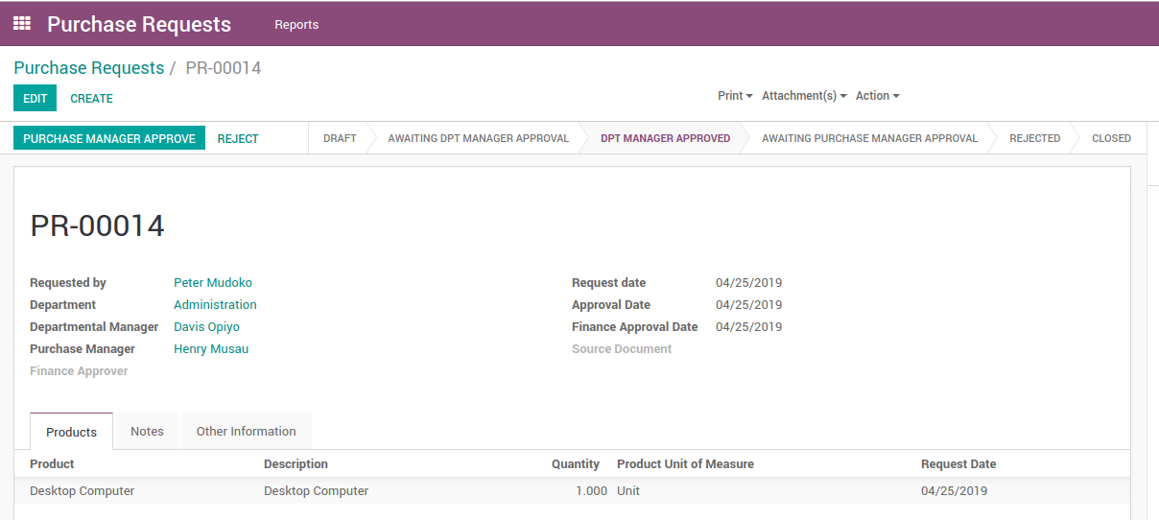
Purchase Manager Approval
The purchase manager clicks on ‘PURCHASE MANAGER APPROVE’

Slide 8
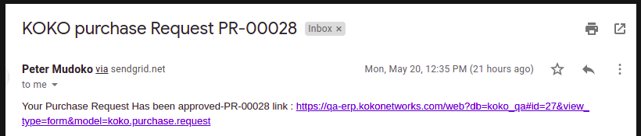
Notification to the Purchase Requestor
Once the PR has been fully authorised by HOD and the Purchase Manager the requestor will get an email notification to alert him/ her of the approval / rejection.

Slide 9
Purchase Order Approval- Odoo ERP

Slide 10
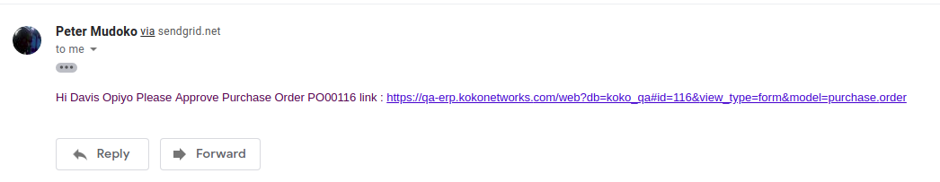
Overview
Whenever a PO is created, an email will be sent to the requestor (Checked by) who will approve and a notification mail triggered to the HOD for approval. Click on the approval link and one will be directed to the PO page.

Slide 11
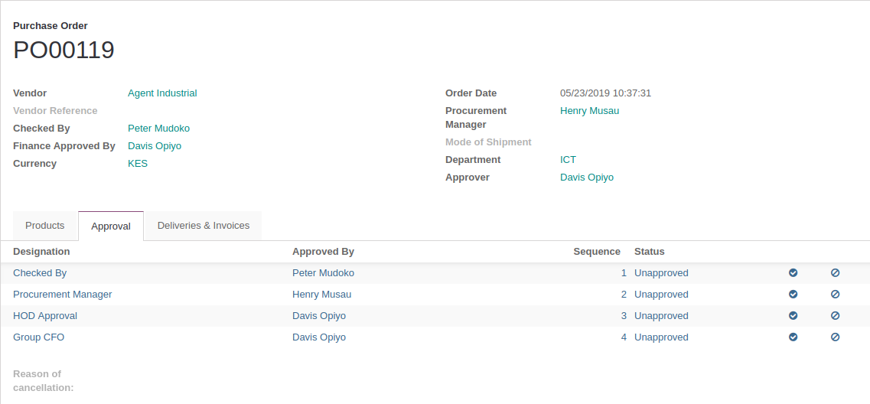
PO Approval Matrix:
On Opening the link to Odoo, click the ‘Approval’ tab and it will display the list of individuals needed to approve the PO in a set sequence. Financial amount threshold will be configured to be approved by different member of the Finance team i.e PO amount less than Ksh 250,000 will be approved by the Group Management Accountant (Smit) and PO amounts greater than Ksh 250,000 will be approved by the Group CFO (Nick)

Slide 12
PO Approval Criteria
The purchase orders will be approved from the odoo system. The approvers shall be the item requestor(Checked by), Purchase Manager, Head of Department and final approval from the Finance department.
Upon creation of the PO, a notification will be sent to the requestor to start the approval cycle. Once he/she approves, a notification mail will be triggered to the second approver (Purchase Manager)to approve, then to the third approver (HOD) and finally to the Finance approver.

Slide 13
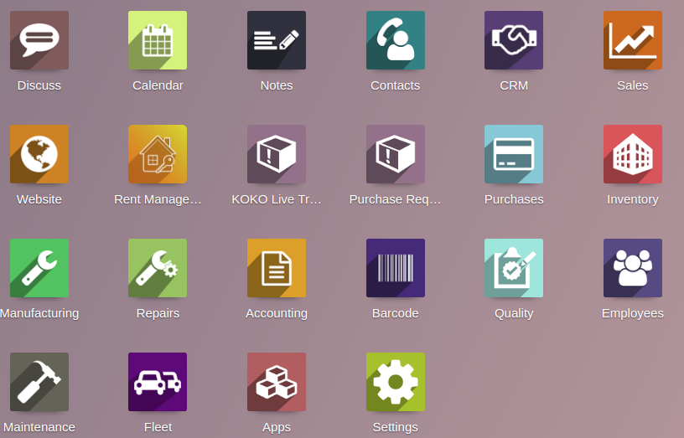
Alternatively a user can log into odoo, click the purchase module and still navigate to the same page to view requests pending approval

Slide 14
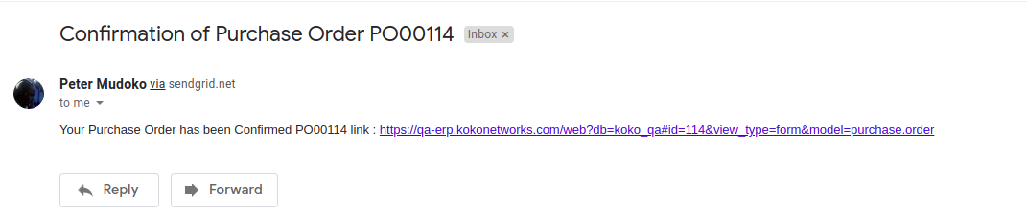
Confirmation Email:
Once all the approval are done, the Purchase manager will receive a confirmation email of the approval, print the PO and send to the supplier a fully signed Purchase Order. The digital signatures will be pre-loaded into Odoo to automatically reflect once the approver has okayed the purchase order.

Slide 15
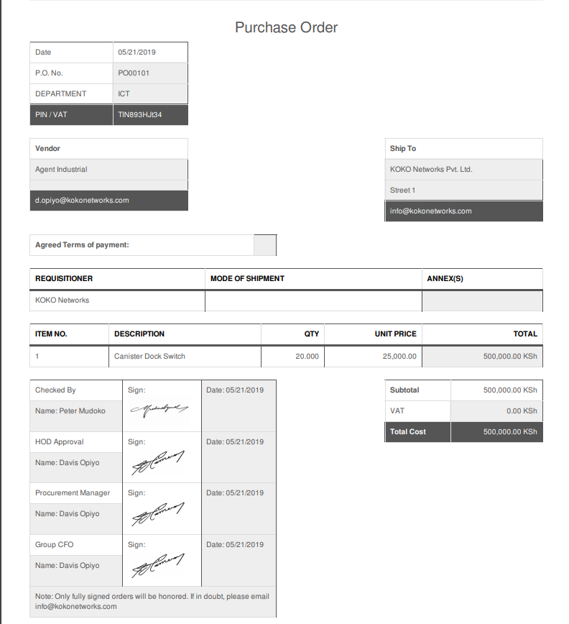

Slide 16
Budget Impact- Odoo ERP

Slide 17
Analytic Account:
The Purchase orders created will be linked to the departmental budgets (Analytic Account) and the amount will automatically deduct whenever POs for the departments are raised and approved. The ‘Practical Amount’ column will always show the total monetary value of the Purchase orders raised from that department.

Slide 18
